Slide 1
Chapter 4: Everything Needs to be Secured
IOT CƠ BẢN
502068

Slide 2
Ghi chú về bản quyền
Toàn bộ nội dung bài giảng là của CISCO, sinh viên có quyền tải về, lưu trữ, in ấn, tham khảo cho mục đích học tập. Sinh viên không được phát hành lại hay thay đổi nội dung slide nếu chưa có sự đồng ý của chủ sở hữu.
Phần ghi chú ở cuối slide (nếu có) là do các thầy cô ghi chú lại trong quá trình giảng dạy.

Slide 3
Chapter 5: Everything Needs to be Secured
Introduction to the Internet of Things v2.0
Notes:
Cisco Networking Academy Program
Introduction to the Internet of Things
Chapter 5: Everything Generates Data

Slide 4
Chapter 5 - Sections & Objectives
5.1 Security in the Digitized World
Explain why security is important in the digitized world.
Explain the need for security in the digitized world.
Explain how to help secure the corporate world.
Explain how to secure personal data and devices.
Notes:
3
Cisco Networking Academy Program
Introduction to the Internet of Things
Chapter 5: Everything Needs to be Secured

Slide 5
5.1 Security in the Digitized World
Notes:
5 – Everything Needs to be Secured
5.1 – Security in the Digitized World

Slide 6
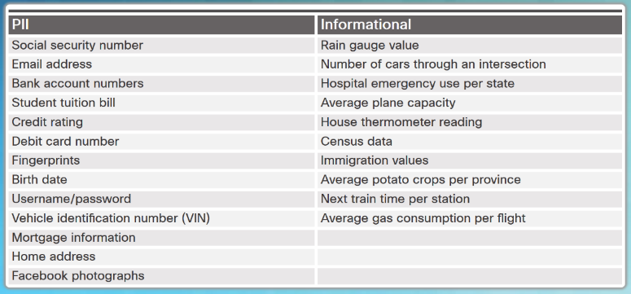
Why is Security so Important? Types of Data
The quantity, volume, variety, and immediacy of generated data has changed.
Personally identifiable information (PII) or sensitive personal information (SPI) is data relating to a living individual that can be used on its own or with other information to identify, contact, or locate a specific individual.
Informational data can also contain sensitive information concerning corporate secrets, new product patents, or national security.
Notes:
5.1 – Security in the Digitized World
5.1.1 – Why is Security so Important?
5.1.1.1 – Types of Data

Slide 7

Why is Security so Important? Who Wants our Data?
The Good Guys
Legitimate companies that have an agreement in place to use the collected data about you.
We agree to this in “Terms and Conditions” or “Terms of Service and Agreements”
White hat hackers who test security to help protect data.
The Bad Guys
Black hat hackers, want access to collected data for many nefarious reasons:
To access user IDs and passwords to steal identities
To access data to commit a crime.
To sell the information to a third party.
To modify the data or disable functionality on a device.
To disrupt or to damage the image of a legitimate company.
To create political unrest or to make a political statement.
Notes:
5.1 – Security in the Digitized World
5.1.1 – Why is Security so Important?
5.1.1.3 – Who Wants our Data?

Slide 8

Why is Security so Important? Data in the Wrong Hands
Login credentials and other personal data for more than one Million Yahoo and Gmail accounts are reportedly being offered for sale on the dark web.
Cybercriminals penetrated Equifax (EFX), one of the largest credit bureaus, in July 2017 and stole the personal data of 145 million people
A breach of MyFitnessPal affected 150 million users.
Ransomware attackers stole 57 million drivers and rider accounts from Uber.
Notes:
5.1 – Security in the Digitized World
5.1.1 – Why is Security so Important?
5.1.1.4 – Data in the Wrong Hands

Slide 9
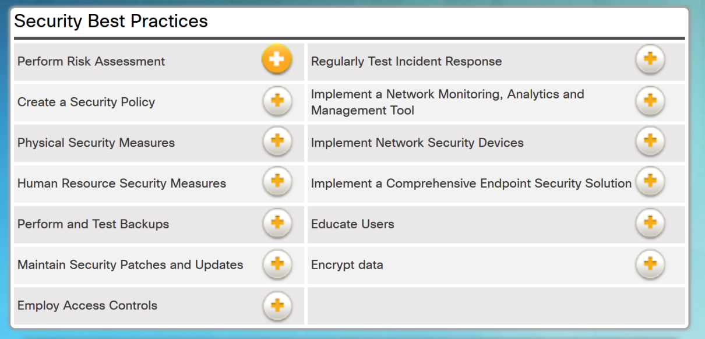
Why is Security so Important? Security Best Practices
Notes:
5.1 – Security in the Digitized World
5.1.2 – Protecting the Corporate world
5.1.2.1 – Security Best Practices

Slide 10
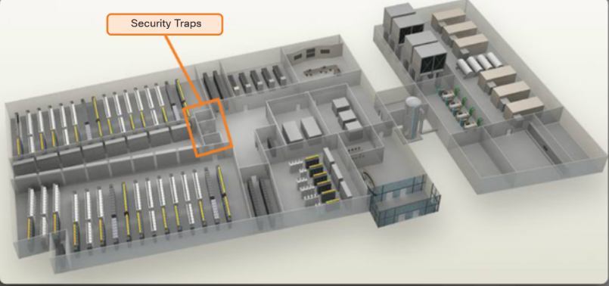
Protecting the Corporate World Physical Security
Outside perimeter security - on-premise security officers, fences, gates, continuous video surveillance, and security breach alarms.
Inside perimeter security - continuous video surveillance, electronic motion detectors, security traps, and biometric access and exit sensors.
Notes:
5.1 – Security in the Digitized World
5.1.2 – Protecting the Corporate World
5.1.2.2 – Physical Security

Slide 11

Protecting the Corporate World Challenges of Securing IoT Devices
Increasing Number of Devices - The number of interconnected sensors and smart devices is growing exponentially, increasing the opportunity for attacks.
Non-Traditional Location of Devices - Some connected IoT devices are able to interact with the physical world.
Lack of Upgradeability - IoT sensor-enabled devices may be located in remote and/or inaccessible locations where human intervention or configuration is almost impossible.
Notes:
5.1 – Security in the Digitized World
5.1.2 – Protecting the Corporate World
5.1.2.3 – Challenges of Securing IoT Devices

Slide 12
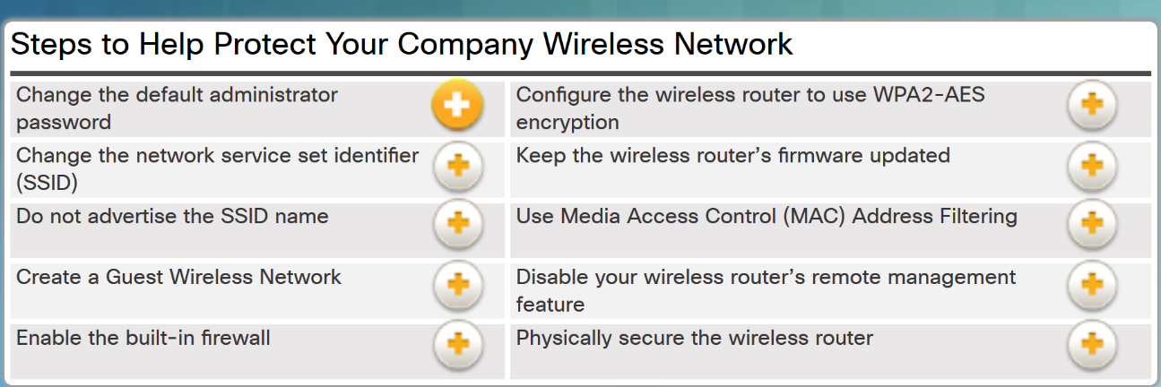
Protecting the Corporate World Safe Wi-Fi Usage
Notes:
5.1 – Security in the Digitized World
5.1.2 – Protecting the Corporate World
5.1.2.4 – Safe Wi-Fi Usage

Slide 13
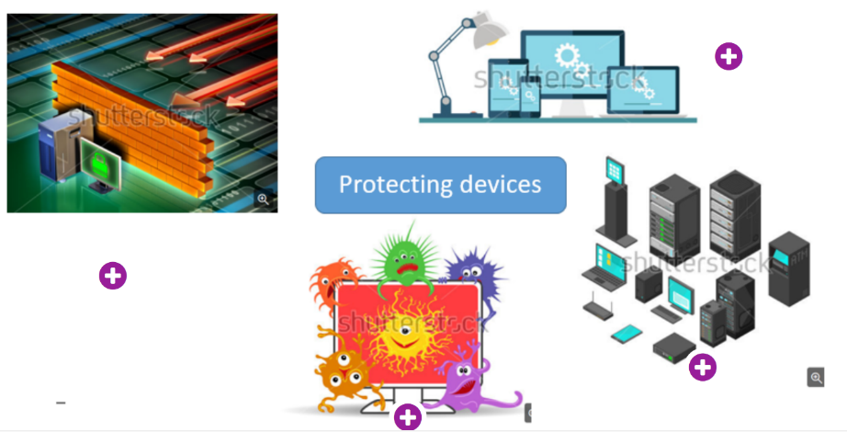
Protecting the Corporate World Protecting Devices
Keep the Firewall On
Manage Your Operating System and Browser
Protect All Your Devices
Use Antivirus and Antispyware
Notes:
5.1 – Security in the Digitized World
5.1.2 – Protecting the Corporate World
5.1.2.5 – Protecting Devices

Slide 14
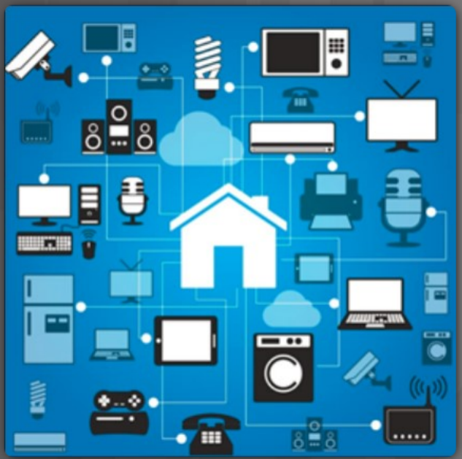
Securing Personal Data and Devices Smart Homes
Smart sensors in our homes increase the potential for security issues.
The sensors could provide a way for hackers to get into our home network and gain access to any PCs and data that are connected to it.
Before purchasing home security systems, it is very important to research the developer and the security and encryption protocols that are in place for its products.
Notes:
5.1 – Security in the Digitized World
5.1.3 – Securing Personal Data and Devices
5.1.3.3 – Smart Homes

Slide 15
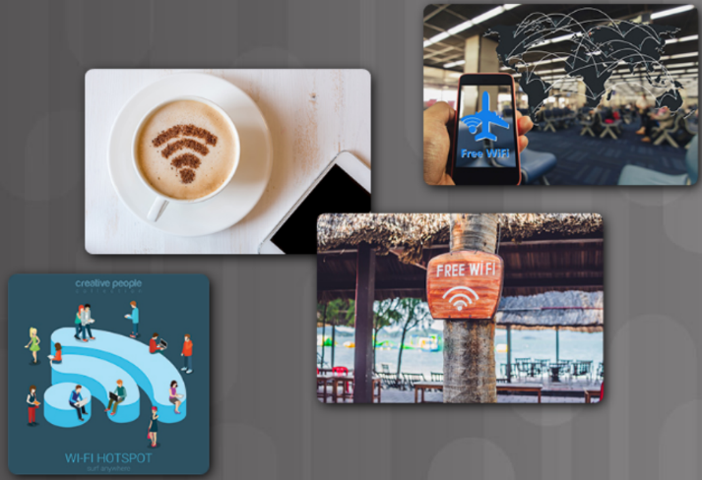
Securing Personal Data and Devices Public Hotspots
Safety rules to follow when using a public or unsecure Wi-Fi hotspot:
Do not access or send any sensitive personal information
Verify that your computer is configured with file and media sharing, and that it requires user authentication with encryption.
Use encrypted virtual private network (VPN) tunnels and services.
Bluetooth can be exploited by hackers to eavesdrop on some devices, establish remote access controls, distribute malware, and drain batteries.
Turn off when not in use.
Notes:
5.1 – Security in the Digitized World
5.1.3 – Securing Personal Data and Devices
5.1.3.4 – Public Hotspots

Slide 16
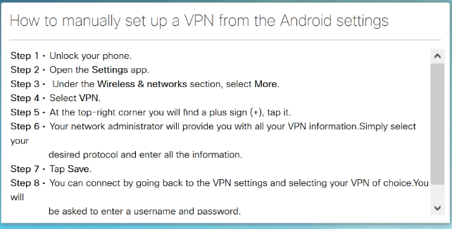
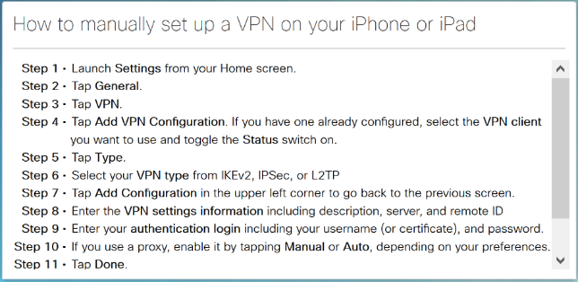
Securing Personal Data and Devices Setting up a VPN on Smartphones
Notes:
5.1 – Security in the Digitized World
5.1.3 – Securing Personal Data and Devices
5.1.3.5 – Setting up a VPN on Smartphones

Slide 17

Securing Personal Data and Devices Lab - Discover Your Own Risky Online Behavior
Notes:
5.1 – Security in the Digitized World
5.1.3 – Securing Personal Data and Devices
5.1.3.6 – Lab - Discover Your Own Risky Online Behavior

Slide 18
5.2 Chapter Summary
Notes:
5 – Everything Needs to be Secured
5.2 - Summary

Slide 19
Chapter Summary Summary
The quantity, volume, variety, and immediacy of generated data has changed.
Personally identifiable information (PII) or sensitive personal information (SPI) is data relating to a living individual that can be used on its own or with other information to identify, contact, or locate a specific individual.
Informational data can also contain sensitive information concerning corporate secrets, new product patents, or national security.
White hat hackers test security to help protect data.
Black hat hackers, want access to collected data for many nefarious reasons.
Outside perimeter security - on-premise security officers, fences, gates, continuous video surveillance, and security breach alarms.
Inside perimeter security - continuous video surveillance, electronic motion detectors, security traps, and biometric access and exit sensors.
Notes:
5 – Everything Needs to be Secured
5.2 – Summary

Slide 20
Chapter Summary Summary (Cont.)
Challenges of securing devices on the IoT:
Increasing Number of Devices - The number of interconnected sensors and smart devices is growing exponentially, increasing the opportunity for attacks.
Non-Traditional Location of Devices - Some connected IoT devices are able to interact with the physical world.
Lack of Upgradeability - IoT sensor-enabled devices may be located in remote and/or inaccessible locations where human intervention or configuration is almost impossible.
Know the steps to protect your company’s wireless network.
Steps for protecting your own devices:
Keep the Firewall On
Manage Your Operating System and Browser
Protect All Your Devices
Use Antivirus and Antispyware
Notes:
5 – Everything Needs to be Secured
5.2 – Summary

Slide 21
Chapter Summary Summary (Cont.)
Smart sensors in our homes increase the potential for security issues.
Safety rules to follow when using a public or unsecure Wi-Fi hotspot:
Do not access or send any sensitive personal information
Verify that your computer is configured with file and media sharing, and that it requires user authentication with encryption.
Use encrypted virtual private network (VPN) tunnels and services.
Set up a VPN on your smart phone.
Notes:
5 – Everything Needs to be Secured
5.2 – Summary

Slide 23
Chapter 6: Educational and Business Opportunities
Introduction to the Internet of Things v2.0
Notes:
Cisco Networking Academy Program
Introduction to the Internet of Things
Chapter 6: Educational and Business Opportunities

Slide 24
Chapter 6 - Sections & Objectives
6.1 Explain the challenges and opportunities that exist in the digitized world.
Explain the challenges and opportunities that exist in the digitized world.
Describe the educational opportunities and communities of interest related to IoT.
Notes:
23
Cisco Networking Academy Program
Introduction to the Internet of Things
Chapter 6: Educational and Business Opportunities

Slide 25
6.1 Where Can I Go from Here?
Notes:
6 – Educational and Business Opportunities
6.1 – Where Can I Go from Here?

Slide 26

Challenges and Opportunities in the Digital World Become an Informed Consumer
Technical gains, together with recent developments in automation and artificial intelligence, have created a highly digitized world.
Digitization currently impacts every aspect of our daily lives and continues to provide new opportunities for professionals.
The IoT provides an immeasurable amount of information that is readily available for consumption.
Think about what else has changed in your life because of the IoT.
The IoT is also freeing humans from the drudgery of routine and repetitive tasks such as restocking shelves and order fulfillment.
How will you use the IoT to help improve the future?
Notes:
6.1 – Where Can I Go from Here?
6.1.1 – Challenges and Opportunities in the Digital World
6.1.1.1 – Become an Informed Consumer

Slide 27

Challenges and Opportunities in the Digital World Challenges in the Digitized World
We are now faced with an ever expanding collection of new technology that we must master.
Transformational technologies that we have experienced in recent history.
The development of the automobile allowed for greater mobility of the workforce and increased recreational activities.
The personal computer allowed the automation of many routine tasks and improved their accuracy and efficiency.
The Internet started to break down geographic barriers and improve equality between people on a global scale.
Each perceived challenge opens up many new opportunities.
Can you imagine how your life would be without a car, personal computer, or access to the Internet?
Notes:
6.1 – Where Can I Go from Here?
6.1.1 – Challenges and Opportunities in the Digital World
6.1.1.2 – Challenges in the Digitized World

Slide 28

Challenges and Opportunities in the Digital World The Evolving Job Market
Traditional jobs are being replaced with jobs that are designed to embrace this new world and all it offers.
These jobs reflect skills spanning multiple disciplines that include computer science, computer engineering, and software engineering in the following areas:
Artificial Intelligence
Application Development
IoT Program Developer
IoT Security Specialist
Collaboration
Enterprise Networks
Data Center and Virtualization
Notes:
6.1 – Where Can I Go from Here?
6.1.1 – Challenges and Opportunities in the Digital World
6.1.1.3 – The Evolving Job Market

Slide 29
Challenges and Opportunities in the Digital World The Evolving Job Market (Cont.)
There are broad categories that summarize the job opportunities that exist in the evolving digitized world:
Enablers – These jobs develop and implement the underlying technology.
Engagers –These jobs design, create, integrate, and deliver IoT services to customers.
Enhancers – These jobs devise their own value-added services, on top of the services provided by Engagers, which are unique to the Internet of Things.
Notes:
6.1 – Where Can I Go from Here?
6.1.1 – Challenges and Opportunities in the Digital World
6.1.1.3 – The Evolving Job Market

Slide 30
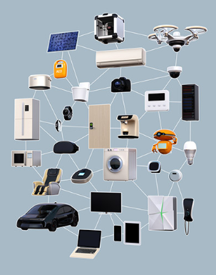
Challenges and Opportunities in the Digital World Entrepreneurs needed!
New kind of IT specialist needed! Individuals with the knowledge and skillsets to develop new IoT-enabled products and process the data they collect.
An entrepreneurial workforce is needed that specializes in both information science and software or computer engineering.
People must collaborate and learn from each other to understand the things, the networks, and methodologies that harness the limitless potential of the IoT.
Notes:
6.1 – Where Can I Go from Here?
6.1.1 – Challenges and Opportunities in the Digital World
6.1.1.4 – Entrepreneurs needed!

Slide 31

Challenges and Opportunities in the Digital World Lifelong Learning
With the ever changing landscape of the digitized world, we must stay current in order to realize the full potential of what the IoT has to offer.
The job market will continue to offer more opportunities as new technologies evolve.
The skill sets required for these jobs will evolve at the same time, thus creating the need for lifelong learning.
Notes:
6.1 – Where Can I Go from Here?
6.1.1 – Challenges and Opportunities in the Digital World
6.1.1.5 – Lifelong Learning

Slide 32
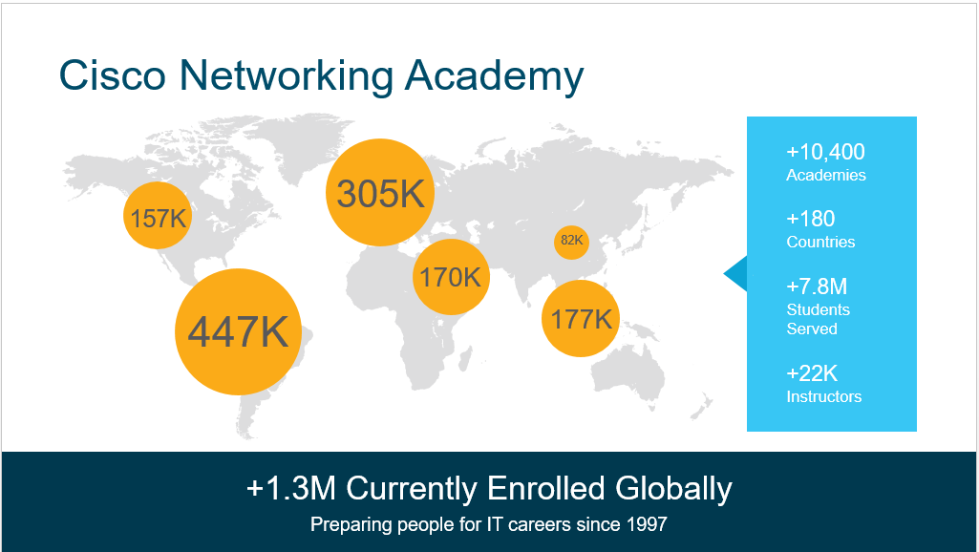
Educational and Professional Opportunities Cisco Networking Academy
There is a global shortage of people who are qualified to implement and maintain networking solutions.
Cisco Networking Academy:
Helps individuals prepare for industry-recognized certifications and entry-level information and communication technology (ICT) careers in virtually every type of industry.
Trained more than five million students to date.
Many graduates have gone on to successful IT careers in a variety of industries, while others have started their own businesses.
Notes:
6.1 – Where Can I Go from Here?
6.1.2 – Educational and Professional Opportunities
6.1.2.1 – Cisco Networking Academy

Slide 33
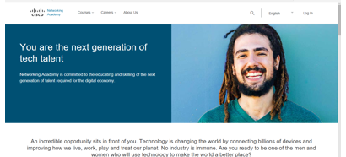
Educational and Professional Opportunities Networking Academy Curriculum
Students complete hands-on learning activities and network simulations to develop practical skills that will help them find jobs in IT.
These are some of the offerings of the Networking Academy:
IoT Fundamentals
IT Essentials
Entrepreneurship
Introduction to Cybersecurity
CCNA Routing and Switching
CCNA Security
CCNP
For more information on our latest offerings, go to the Networking Academy website at www.netacad.com.
Notes:
6.1 – Where Can I Go from Here?
6.1.2 – Educational and Professional Opportunities
6.1.2.2 – Networking Academy Curriculum

Slide 34

Educational and Professional Opportunities Communities of Interest
A community of interest is a group of people who share a common interest or passion about a specific topic.
IEEE and LinkedIn have an IoT community.
Some communities are supported by industry and provide a place to help development of their products and technology, as well as those of their business partners. Two such communities provided by Cisco are the Cisco Learning Network and Cisco DevNet.
Cisco Learning Network is designed for people who wish to develop their skills in various Cisco technologies and pursue Cisco certification. learningnetwork.cisco.com
DevNet is a Developer Program from Cisco that consists of a website, an interactive developer community, coordinated developer tools, integrated discussion forums, and sandboxes. developer.cisco.com
Notes:
6.1 – Where Can I Go from Here?
6.1.2 – Educational and Professional Opportunities
6.1.2.3 – Communities of Interest

Slide 35
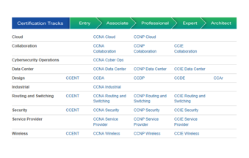
Educational and Professional Opportunities Industry Certifications
Industry certifications are highly respected by employers around the world and help validate the skills needed to launch successful careers in networking and IT.
Certifications are achieved by passing an exam proctored by a certifying authority.
There are two basic types of certification available: vendor-specific and vendor-neutral.
Most often, certifications must be renewed over time.
To explore all of the different Cisco career certifications, visit the following website: https://learningnetwork.cisco.com.
Notes:
6.1 – Where Can I Go from Here?
6.1.2 – Educational and Professional Opportunities
6.1.2.4 – Industry Certifications

Slide 36

Educational and Professional Opportunities Additional Learning Resources
Community college or university degrees can show that a person has gained a broad understanding in a field of study.
A combination of industry certifications and university degrees provides a student with the best background, experience, and education to pursue a career with greater opportunities and higher salary.
Look for a degree to pursue at a community college or university that will pertain to the skillsets needed for a career in IoT, watch for some of the following degrees:
Business Intelligence
Computer Information Systems
Computer Programming
Computer Science
Database Administration
Electromechanical Automation
Electronics Engineering
Linux Networking
Machining
Network Administration
System Analysis
Web Server Administrator
Notes:
6.1 – Where Can I Go from Here?
6.1.2 – Educational and Professional Opportunities
6.1.2.5 – Additional Learning Resources

Slide 37
6.2 Chapter Summary
Notes:
6 – Educational and Business Opportunities
6.2 - Summary

Slide 38
Chapter Summary Summary
Technical gains, together with recent developments in automation and artificial intelligence, have created a highly digitized world.
Digitization currently impacts every aspect of our daily lives and continues to provide new opportunities for professionals.
We are now faced with an ever expanding collection of new technology that we must master.
Traditional jobs are being replaced with jobs that are designed to embrace this new world and all it offers.
There are broad categories that summarize the job opportunities that exist in the evolving digitized world:
Enablers – These jobs develop and implement the underlying technology.
Engagers –These jobs design, create, integrate, and deliver IoT services to customers.
Enhancers – These jobs devise their own value-added services, on top of the services provided by Engagers, which are unique to the Internet of Things.
Notes:
6 – Educational and Business Opportunities
6.2 – Summary

Slide 39
Chapter Summary Summary (Cont.)
An entrepreneurial workforce is needed that specializes in both information science and software or computer engineering.
People must collaborate and learn from each other to understand the things, the networks, and methodologies that harness the limitless potential of the IoT.
The job market will continue to offer more opportunities as new technologies evolve.
The skill sets required for these jobs will evolve at the same time, thus creating the need for lifelong learning.
Cisco Networking Academy:
Helps individuals prepare for industry-recognized certifications and entry-level information and communication technology (ICT) careers in virtually every type of industry.
Trained more than five million students to date.
For more information on our latest offerings, go to the Networking Academy website at www.netacad.com.
Notes:
6 – Educational and Business Opportunities
6.2 – Summary

Slide 40
Chapter Summary Summary (Cont.)
A community of interest is a group of people who share a common interest or passion about a specific topic.
Cisco Learning Network is designed for people who wish to develop their skills in various Cisco technologies and pursue Cisco certification. learningnetwork.cisco.com
DevNet is a Developer Program from Cisco that consists of a website, an interactive developer community, coordinated developer tools, integrated discussion forums, and sandboxes. developer.cisco.com
Certifications are achieved by passing an exam proctored by a certifying authority.
There are two basic types of certification available: vendor-specific and vendor-neutral.
To explore all of the different Cisco career certifications, visit the following website: https://learningnetwork.cisco.com.
Community college or university degrees can show that a person has gained a broad understanding in a field of study.
Notes:
6 – Educational and Business Opportunities
6.2 – Summary

